Slide 1


CS-446: Information Systems Security
CHAPTER 1: Security Goals, History of Attack and Underground Economy
Lecturer Abdullah Bin Zarshaid
Department of Computer Science
FAST-NUCES

Slide 2
What is This Class About ?
Learn About Security
Make a Difference

Slide 3
How Can You Make a Difference?
Be a more security-- aware user
Make better security decisions
Be a more security– aware developer
Design & build more secure systems
Be a security practitioner & researcher
Identify security issues
Propose new security solutions

Slide 4
Computer Security Today

Slide 5


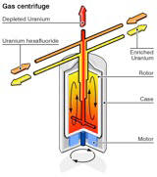
Why Computer Security ?
Computer systems are ubiquitous in our daily life
Computers store and process our data and information
Computers access and control our resources
Valuable Data
Private Data
Dangerous Data

Slide 6
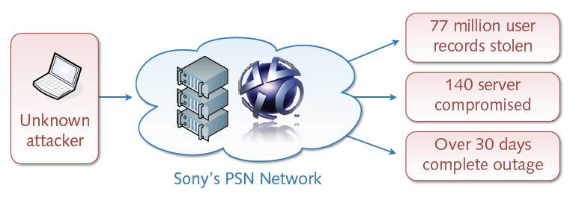
The Sony Breach
An Example: The Playstation Network (PSN) Attack
Illegal intrusion into network around April 2011
Severe consequences for users and companies
Financial damage of over 24 billion dollars

Slide 7
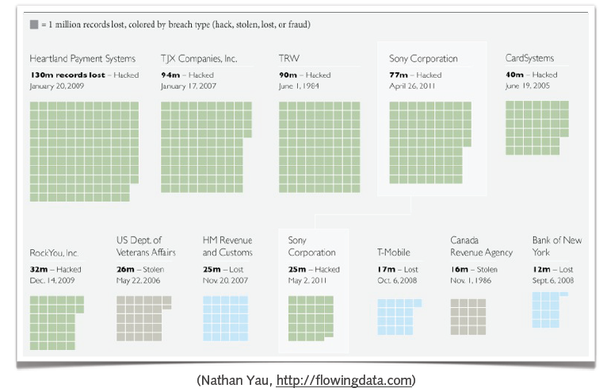
Top Data Breaches

Slide 8
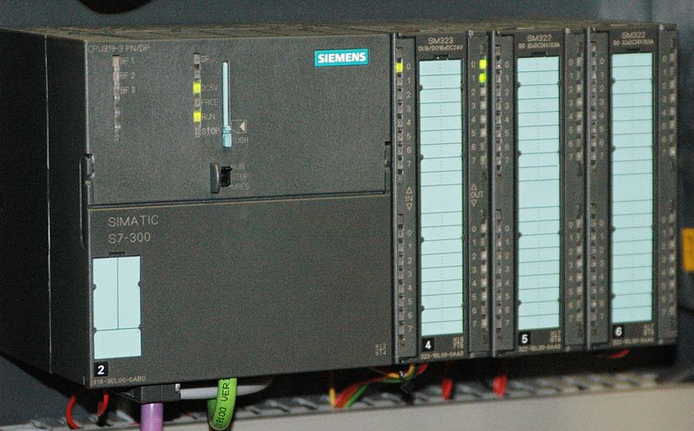
Further Example
Stuxnet Worm
Computer worm detected in January 2010
Initially spread via MS Windows and targets Siemens industrial software and equipment (SCADA)
Spies on and disrupts industrial systems
Possible sabotage against uranium enrichment infrastructure in Iran
Rustock Botnet
Network of 1.7 million infected systems (zombies)
Capability of sending 22 million spam messages per day
Active from around 2007 to March 2011
Taken down by Microsoft, U.S. Fed Agents and University of Washington
On July 18, 2011, Microsoft put a bounty of US$ 250 K on the individual behind Rustock botnet.
Notes:
Stuxnet
Stuxnet is a highly sophisticated computer worm. Discovered in June 2010, Stuxnet initially spreads via Microsoft Windows, and targets Siemens industrial software and equipment. While it is not the first time that hackers have targeted industrial systems, it is the first discovered malware that spies on and subverts industrial systems, and the first to include a programmable logic controller (PLC)rootkit.
The worm initially spreads indiscriminately, but includes a highly specialized malware payload that is designed to target only Siemens supervisory control and data acquisition (SCADA) systems that are configured to control and monitor specific industrial processes. Stuxnet infects PLCs by subverting the Step-7 software application that is used to reprogram these devices.
Different variants of Stuxnet targeted five Iranian organizations, with the probable target widely suspected to be uranium enrichment infrastructure in Iran
Rustock
On March 16, 2011, the botnet was taken down through what was initially reported as a coordinated effort by Internet service providers and software vendors. It was revealed the next day that the take-down, called Operation b107, was the action of Microsoft, U.S. federal law enforcement agents, FireEye, and the University of Washington.
To capture the individuals involved with the Rustock botnet, on July 18, 2011, Microsoft is offering "a monetary reward in the amount of US$250,000 for new information that results in the identification, arrest and criminal conviction of such individual(s)."

Slide 9
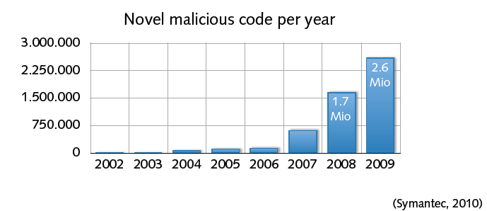
… more trouble ahead
Cyberspace — a dangerous place
Omnipresence of computer attacks, viruses and worms
Persistent underground economy (worth billions of dollars)
Soon cyber-terrorism and cyber-warfare?
Notes:
OmniPresence … ?

Slide 10
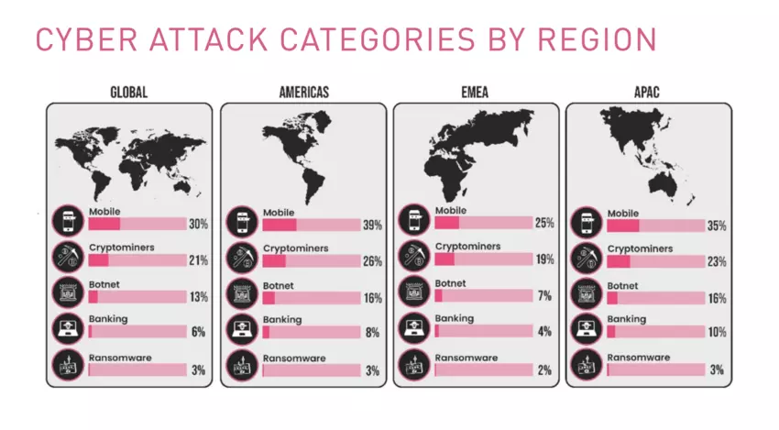
These will be the main cybersecurity trends in 2020
https://www.weforum.org/agenda/2020/01/these-will-be-the-main-cybersecurity-trends-in-2020/

Slide 11
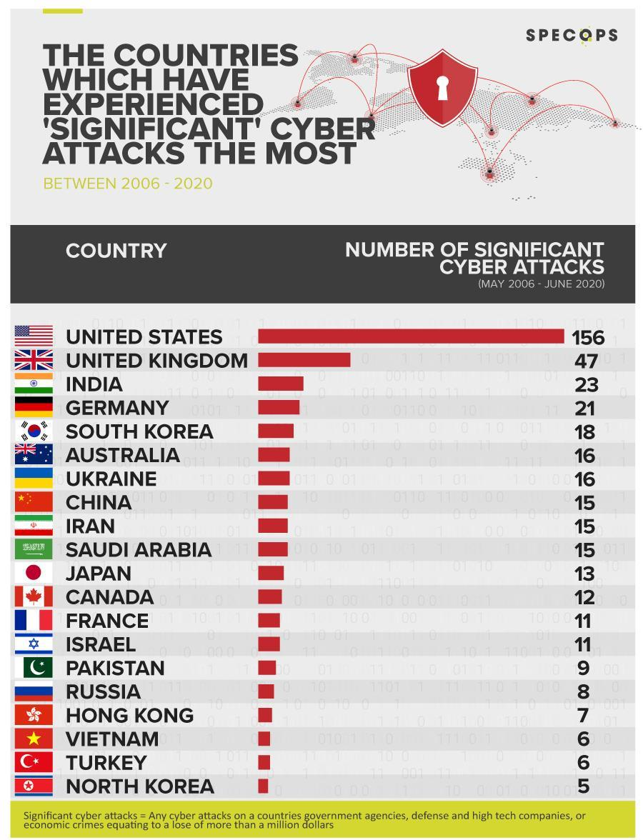
https://www.complianceweek.com/cyber-security/study-us-largest-target-for-significant-cyber-attacks/29180.article

Slide 12
Must See this Doc Reading Assignment(Important)
https://www.checkpoint.com/downloads/resources/cyber-attack-trends-mid-year-report-2019.pdf

Slide 13
List of security hacking incidents see Link
https://en.wikipedia.org/wiki/List_of_security_hacking_incidents
From Wikipedia, the free encyclopaedia

Slide 14
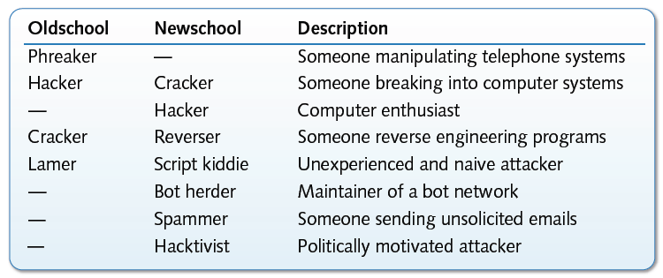
Who is who ?
Informal terminology of attackers
Various other types of attackers, e.g. crime, military, agencies, ...

Slide 15
Informal terminology of attackers conti.
Hackers can be classified into different categories such as white hat, black hat, and grey hat, based on their intent of hacking a system. These different terms come from old Spaghetti Westerns, where the bad guy wears a black cowboy hat and the good guy wears a white hat.
White Hat Hackers: White Hat hackers are also known as Ethical Hackers. They never intent to harm a system, rather they try to find out weaknesses in a computer or a network system as a part of penetration testing and vulnerability assessments.
Ethical hacking: is not illegal and it is one of the demanding jobs available in the IT industry. There are numerous companies that hire ethical hackers for penetration testing and vulnerability assessments.
Black Hat Hacker: Black Hat hackers, also known as crackers, are those who hack in order to gain unauthorized access to a system and harm its operations or steal sensitive information.
Black Hat hacking is always illegal because of its bad intent which includes stealing corporate data, violating privacy, damaging the system, blocking network communication, etc.
Grey Hat Hackers: are a blend of both black hat and white hat hackers. They act without malicious intent but for their fun, they exploit a security weakness in a computer system or network without the owner’s permission or knowledge.
Their intent is to bring the weakness to the attention of the owners and getting appreciation or a little bounty from the owners.

Slide 16
Informal terminology of attackers conti..
Miscellaneous Hackers
Apart from the above well-known classes of hackers, we have the following categories of hackers based on what they hack and how they do it:
Red Hat Hackers: are again a blend of both black hat and white hat hackers. They are usually on the level of hacking government agencies, top-secret information hubs, and generally anything that falls under the category of sensitive information.
Blue Hat Hackers: is someone outside computer security consulting firms who is used to bug-test a system prior to its launch. They look for loopholes that can be exploited and try to close these gaps. Microsoft also uses the term BlueHat to represent a series of security briefing events.
Elite Hackers: This is a social status among hackers, which is used to describe the most skilled. Newly discovered exploits will circulate among these hackers.
Script Kiddie: is a non-expert who breaks into computer systems by using pre-packaged automated tools written by others, usually with little understanding of the underlying concept, hence the term Kiddie.
Neophyte: "n00b", or "newbie" or "Green Hat Hacker" is someone who is new to hacking or phreaking and has almost no knowledge or experience of the workings of technology and hacking.
Hacktivist: is a hacker who utilizes technology to announce a social, ideological, religious, or political message. In general, most hacktivism involves website defacement or denialof-service attacks.

Slide 17
Security is fun too!
Security is different from other disciplines
Established concepts are put into questions
Intersection with many areas of computer science
Often, it’s a game of good and evil players
Practice and theory of security are often fun
Monitoring, detection and analysis of real attacks
Reasoning about limits of attacks and defenses

Slide 18
Security Goals and Mechanisms

Slide 19
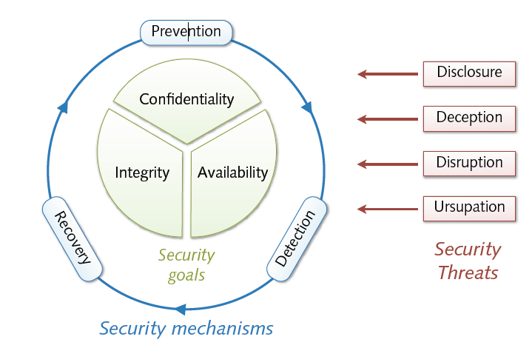
A Formal View

Slide 20
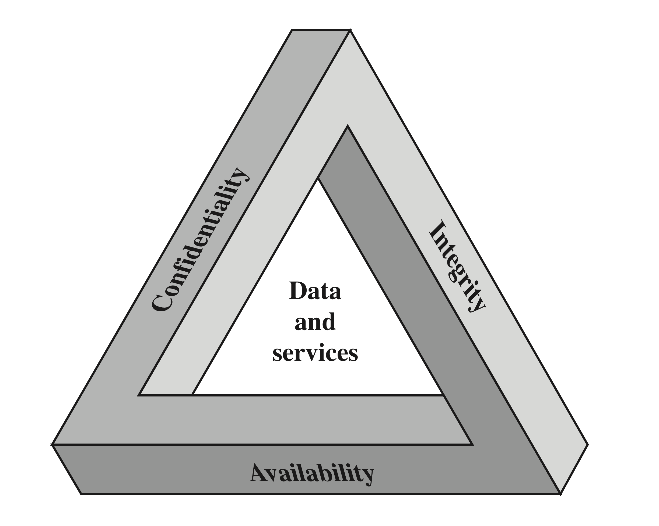
CIA Triad
Notes:
These three concepts form what is often referred to as the CIA triad . The
three concepts embody the fundamental security objectives for both data and for
information and computing services. For example, the NIST Standards for Security
Categorization of Federal Information and Information Systems (FIPS 199) lists
confidentiality, integrity, and availability as the three security objectives for information
and for information systems. FIPS 199 provides a useful characterization
of these three objectives in terms of requirements and the definition of a loss of
security in each category.
• Confidentiality: Preserving authorized restrictions on information access
and disclosure, including means for protecting personal privacy and proprietary
information. A loss of confidentiality is the unauthorized disclosure of
information.
• Integrity: Guarding against improper information modification or destruction,
including ensuring information nonrepudiation and authenticity. A loss of
integrity is the unauthorized modification or destruction of information.
• Availability: Ensuring timely and reliable access to and use of information.
A loss of availability is the disruption of access to or use of information or an
information system.

Slide 21
Security Goals
Security goals (memory hook: “CIA”)
Confidentiality of information and resources
Integrity of information and resources
Availability of information and resources
Basic definitions
Threat = potential violation of a protective goal
Security = protection from intentional threats
Safety = protection from accidental threats

Slide 22

Confidentiality
Confidentiality
Protection of resources from unauthorized disclosure
Check: Who is authorized to access which resources?
Security measures
Encryption of data, resource hiding
Examples
An attacker eavesdrop a telephone conversation
An attacker reads the emails on your computer

Slide 23
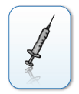
Integrity
Integrity
Protection of resources from unauthorized manipulation
Check: Who does what on which resources?
Security measures
Authorization, checksums, digital fingerprints
Examples
An attacker changes the receipt of a bank transaction
An attacker tampers with files on your computer

Slide 24

Availability
Availability
Protection of resources from unauthorized disruption
Check: When and how are which resources used?
Security Measures
Restriction, redundancy, load balancing
Examples
An attacker crashes the web server of a company
An attacker formats the hard disk of your computer

Slide 25
Computer Security Objectives
Confidentiality
Data confidentiality
Assures that private or confidential information is not made available or disclosed to unauthorized individuals
Privacy
Assures that individuals control or influence what information related to them may be collected and stored and by whom and to whom that information may be disclosed
Integrity
Availability
Assures that systems work promptly and service is not denied to authorized users
Assures that a system performs its intended function in an unimpaired manner, free from deliberate or inadvertent unauthorized manipulation of the system
System integrity
Assures that information and programs are changed only in a specified and authorized manner
Data integrity
Notes:
This definition introduces three key objectives that are at the heart of computer
security:
• Confidentiality: This term covers two related concepts:
Data confidentiality: Assures that private or confidential information is
not made available or disclosed to unauthorized individuals.
Privacy: Assures that individuals control or influence what information
related to them may be collected and stored and by whom and to whom
that information may be disclosed.
•Integrity: This term covers two related concepts:
Data integrity: Assures that information and programs are changed only in
a specified and authorized manner.
System integrity: Assures that a system performs its intended function in
an unimpaired manner, free from deliberate or inadvertent unauthorized
manipulation of the system.
• Availability: Assures that systems work promptly and service is not denied to
authorized users.

Slide 26
Possible additional concepts:
Authenticity
Verifying that users are who they say they are and that each input arriving at the system came from a trusted source
Accountability
The security goal that generates the requirement for actions of an entity to be traced uniquely to that entity
Notes:
Although the use of the CIA triad to define security objectives is well established,
some in the security field feel that additional concepts are needed to present
a complete picture. Two of the most commonly mentioned are as follows:
• Authenticity: The property of being genuine and being able to be verified and
trusted; confidence in the validity of a transmission, a message, or message
originator. This means verifying that users are who they say they are and that
each input arriving at the system came from a trusted source.
• Accountability: The security goal that generates the requirement for actions
of an entity to be traced uniquely to that entity. This supports nonrepudiation,
deterrence, fault isolation, intrusion detection and prevention, and after action
recovery and legal action. Because truly secure systems are not yet an
achievable goal, we must be able to trace a security breach to a responsible
party. Systems must keep records of their activities to permit later forensic
analysis to trace security breaches or to aid in transaction disputes.

Slide 27
Threats & Attacks
Basic classes of threats
Disclosure = unauthorized access to information
Deception = acceptance of false data (e.g. masquerading)
Disruption = interruption or prevention of correct operation
Usurpation = unauthorized control of resources
Attack = attempt to violate a security goal (intentional threat)
Often combinations of different threat classes

Slide 28
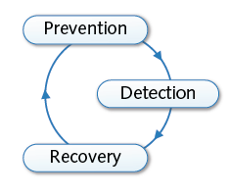
Security Mechanisms
Security policies and mechanisms
Policy = statement of what is and what is not allowed
Mechanism = method or tool enforcing a security policy
Strategies for security mechanisms
Prevention of attacks
Detection of attacks
Recovery from attacks
Bruce Schneier: Security is a process, not a product!

Slide 29
Prevention
Prevention of attacks
Prevention of attacks prior to violation of security goals
Examples
Data reduction and separation
Removal or separation of information and resources
Authentication and encryption
Restriction of access to information and resources
Limitations
Inapplicable in many settings, e.g. open services

Slide 30
Detection
Detection of attacks
Detection of attacks during violation of security goals
Examples
Anti-virus scanners
Detection of malicious code on computers
Network intrusion detection
Detection of attacks in computer networks
Limitations
Ineffective against unknown and “invisible” attacks

Slide 31
Recovery
Recovery
Recovery from attacks after violation of security goals
Examples
Computer forensics
Investigation and analysis of security incidents
Malware analysis
Observation and analysis of malicious software
Limitations
Severe damage might have already occurred

Slide 32
OSI Security Architecture
Security attack
Any action that compromises the security of information owned by an organization
Security mechanism
A process (or a device incorporating such a process) that is designed to detect, prevent, or recover from a security attack
Security service
A processing or communication service that enhances the security of the data processing systems and the information transfers of an organization
Intended to counter security attacks, and they make use of one or more security mechanisms to provide the service
Notes:
To assess effectively the security needs of an organization and to evaluate and
choose various security products and policies, the manager responsible for computer
and network security needs some systematic way of defining the requirements
for security and characterizing the approaches to satisfying those requirements.
This is difficult enough in a centralized data processing environment; with the use of
local and wide area networks, the problems are compounded.
ITU-T Recommendation X.800, Security Architecture for OSI , defines such a
systematic approach. The OSI security architecture is useful to managers as a way
of organizing the task of providing security. Furthermore, because this architecture
was developed as an international standard, computer and communications vendors
have developed security features for their products and services that relate to this
structured definition of services and mechanisms.
For our purposes, the OSI security architecture provides a useful, if abstract,
overview of many of the concepts that this book deals with. The OSI security architecture
focuses on security attacks, mechanisms, and services. These can be defined
briefly as
• Security attack: Any action that compromises the security of information
owned by an organization.
• Security mechanism: A process (or a device incorporating such a process) that
is designed to detect, prevent, or recover from a security attack.
• Security service: A processing or communication service that enhances the
security of the data processing systems and the information transfers of an
organization. The services are intended to counter security attacks, and they
make use of one or more security mechanisms to provide the service.

Slide 33
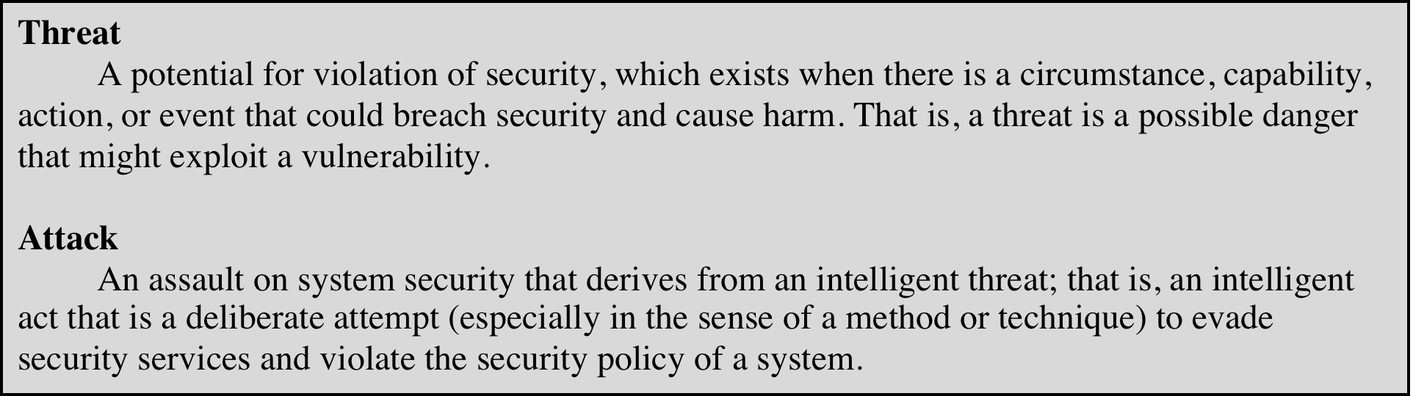
Table 1.1 Threats and Attacks (RFC 4949)
Notes:
In the literature, the terms threat and attack are commonly used to mean more
or less the same thing. Table 1.1 provides definitions taken from RFC 4949, Internet
Security Glossary.

Slide 34
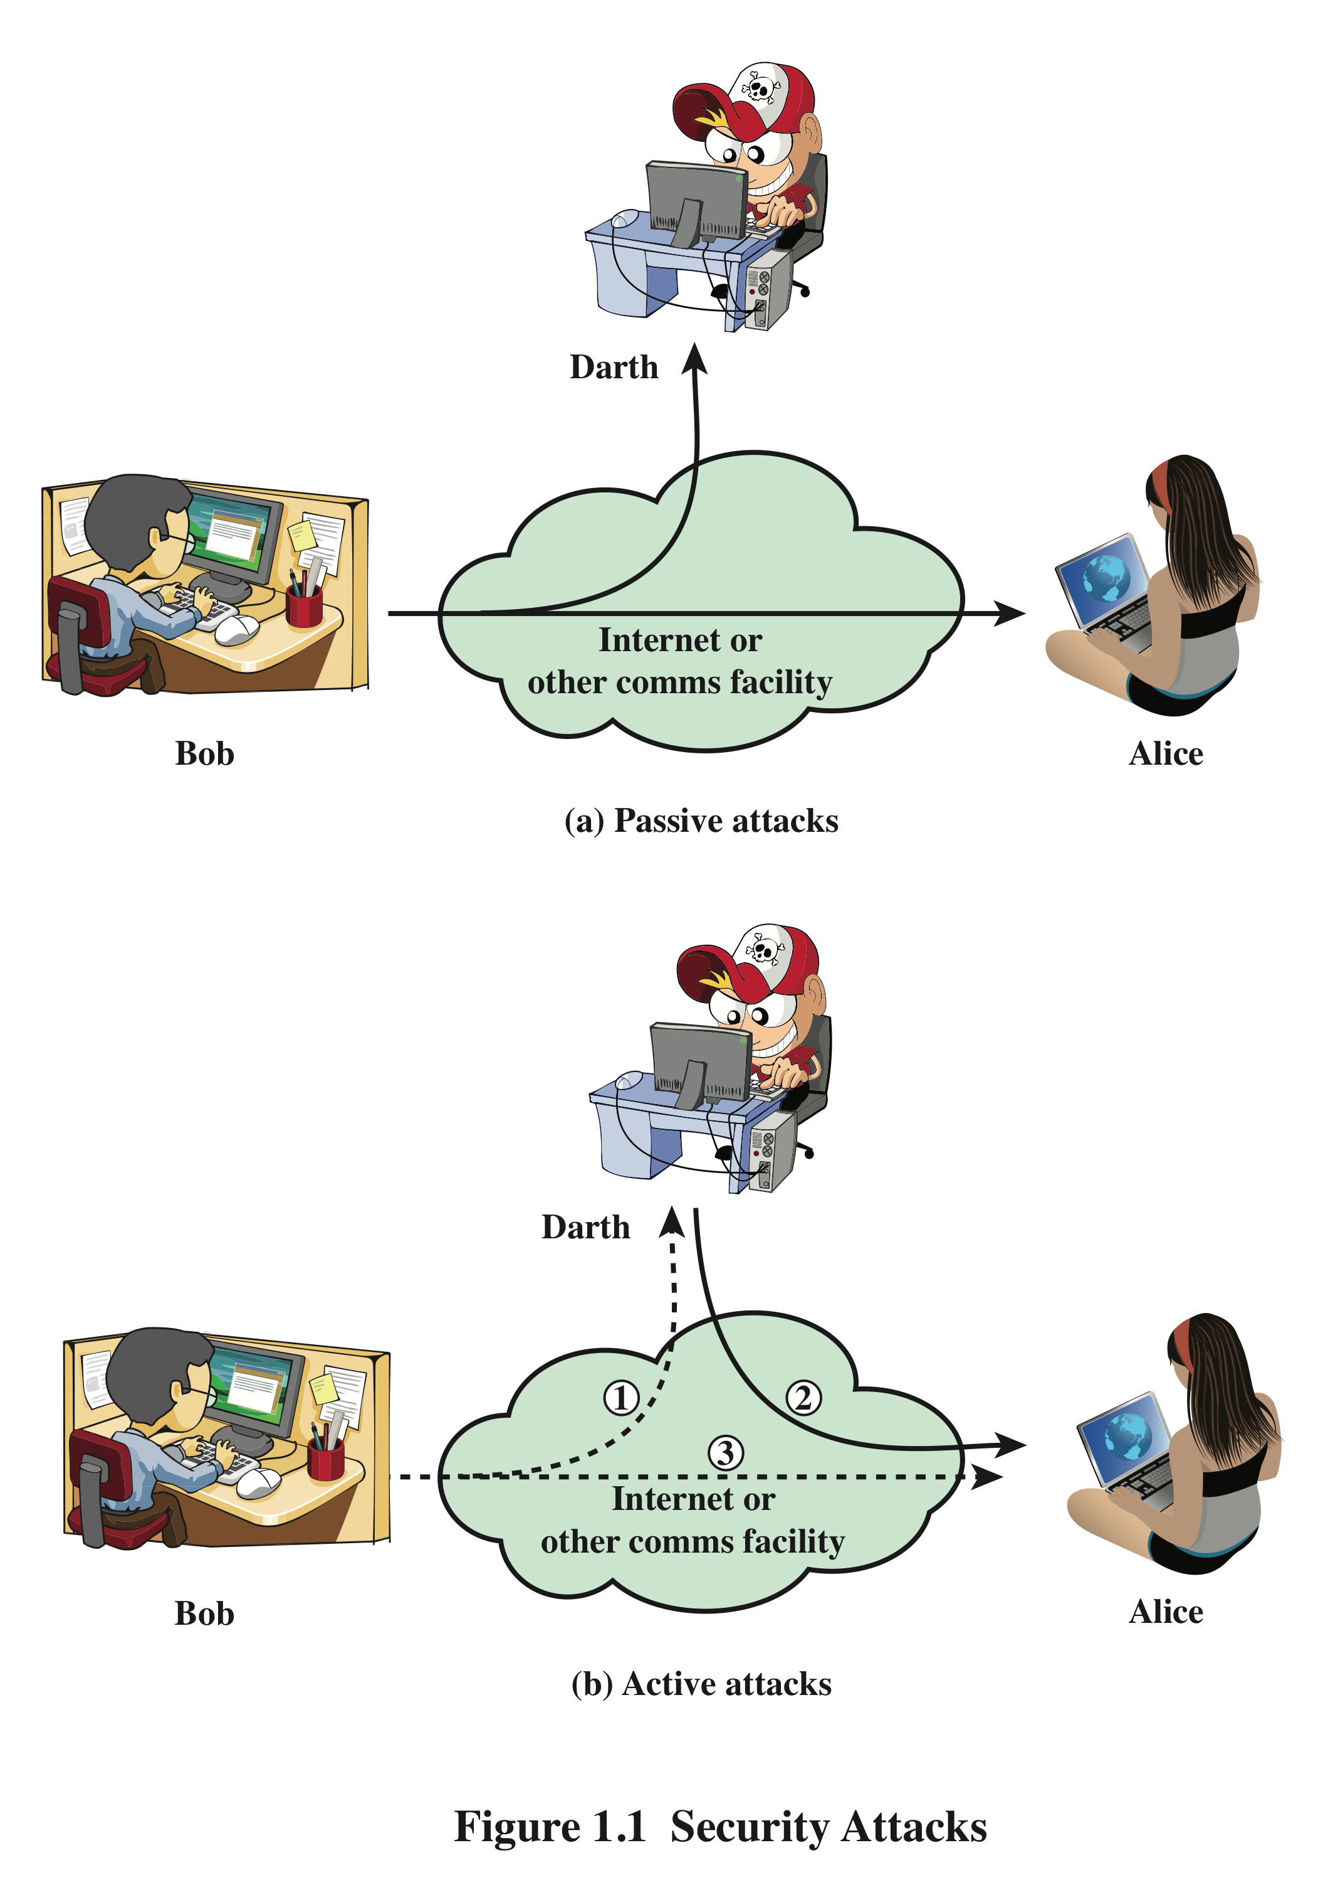
Security Attacks
A means of classifying security attacks, used both in X.800 and RFC 4949, is in terms of passive attacks and active attacks
A passive attack attempts to learn or make use of information from the system but does not affect system resources
An active attack attempts to alter system resources or affect their operation
Notes:
A useful means of classifying security attacks, used both in X.800 and RFC 4949, is in
terms of passive attacks and active attacks (Figure 1.1). A passive attack attempts to
learn or make use of information from the system but does not affect system resources.
An active attack attempts to alter system resources or affect their operation.

Slide 35
Passive Attacks
Are in the nature of eavesdropping on, or monitoring of, transmissions
Goal of the opponent is to obtain information that is being transmitted
Two types of passive attacks are:
The release of message contents
Traffic analysis
Notes:
Passive attacks (Figure 1.1) are in the nature of eavesdropping on, or monitoring
of, transmissions. The goal of the opponent is to obtain information that is being
transmitted. Two types of passive attacks are the release of message contents and
traffic analysis.
The release of message contents is easily understood. A telephone conversation,
an electronic mail message, and a transferred file may contain sensitive or
confidential information. We would like to prevent an opponent from learning the
contents of these transmissions.
A second type of passive attack, traffic analysis , is subtler. Suppose that we
had a way of masking the contents of messages or other information traffic so that
opponents, even if they captured the message, could not extract the information
from the message. The common technique for masking contents is encryption. If we
had encryption protection in place, an opponent might still be able to observe the
pattern of these messages. The opponent could determine the location and identity
of communicating hosts and could observe the frequency and length of messages
being exchanged. This information might be useful in guessing the nature of the
communication that was taking place.
Passive attacks are very difficult to detect, because they do not involve any
alteration of the data. Typically, the message traffic is sent and received in an apparently
normal fashion, and neither the sender nor receiver is aware that a third party
has read the messages or observed the traffic pattern. However, it is feasible to prevent
the success of these attacks, usually by means of encryption. Thus, the emphasis
in dealing with passive attacks is on prevention rather than detection.

Slide 36
Active Attacks
Involve some modification of the data stream or the creation of a false stream
Difficult to prevent because of the wide variety of potential physical, software, and network vulnerabilities
Goal is to detect attacks and to recover from any disruption or delays caused by them
Masquerade
Takes place when one entity pretends to be a different entity
Usually includes one of the other forms of active attack
Replay
Involves the passive capture of a data unit and its subsequent retransmission to produce an unauthorized effect
Modification of messages
Some portion of a legitimate message is altered, or messages are delayed or reordered to produce an unauthorized effect
Denial of service
Prevents or inhibits the normal use or management of communications facilities
Notes:
Active attacks (Figure 1.1b) involve some modification of the data stream or the
creation of a false stream and can be subdivided into four categories: masquerade,
replay, modification of messages, and denial of service.
A masquerade takes place when one entity pretends to be a different entity
(path 2 of Figure 1.1b is active). A masquerade attack usually includes one of the
other forms of active attack. For example, authentication sequences can be captured
and replayed after a valid authentication sequence has taken place, thus enabling an
authorized entity with few privileges to obtain extra privileges by impersonating an
entity that has those privileges.
Replay involves the passive capture of a data unit and its subsequent retransmission
to produce an unauthorized effect (paths 1, 2, and 3 active).
Modification of messages simply means that some portion of a legitimate
message is altered, or that messages are delayed or reordered, to produce an
unauthorized effect (paths 1 and 2 active). For example, a message meaning “Allow
John Smith to read confidential file accounts ” is modified to mean “Allow Fred
Brown to read confidential file accounts. ”
The denial of service prevents or inhibits the normal use or management of
communications facilities (path 3 active). This attack may have a specific target; for
example, an entity may suppress all messages directed to a particular destination
(e.g., the security audit service). Another form of service denial is the disruption
of an entire network, either by disabling the network or by overloading it with
messages so as to degrade performance.
Active attacks present the opposite characteristics of passive attacks. Whereas
passive attacks are difficult to detect, measures are available to prevent their success.
On the other hand, it is quite difficult to prevent active attacks absolutely
because of the wide variety of potential physical, software, and network vulnerabilities.
Instead, the goal is to detect active attacks and to recover from any disruption
or delays caused by them. If the detection has a deterrent effect, it may also
contribute to prevention.

Slide 37
Examples of Attacks
Snooping = passive eavesdropping of information
→ disclosure
✸ network sniffing, keyboard logging
Manipulation = active modification of information
→ deception, disruption and usurpation
✸ redirection of control flow, man-in-the-middle attacks
Spoofing = impersonation of one entity by another
→ deception and usurpation
✸ address spoofing, phishing attacks
Notes:
usurpation

Slide 38
Further Concepts
Authenticity = truthfulness of information and resources
May be viewed as an aspect of integrity
Accountability = linking of actions and users
Realization of non-repudiation in computer systems
Privacy = Security and control of personal information
Property of individuals and not of data
Notes:
Non-repudiation : purported maker of a statement will not be able to successfully challenge the validity of the statement

Slide 39
History of Attacks

Slide 40
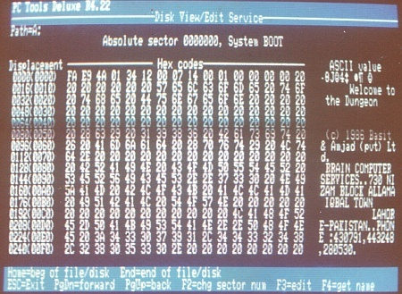
Brain: Where it all started …..
Brain released in January 1986, is considered to be the first computer virus for MS-DOS.
Infects the boot sector of storage media formatted with the DOS File Allocation Table (FAT) file system.
Written by two brothers, Basit Farooq Alvi and Amjad Farooq Alvi from lahore.

Slide 41
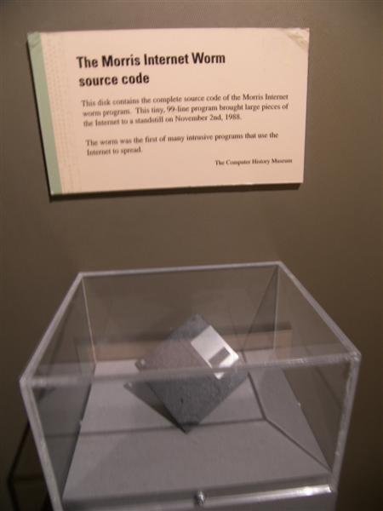
Morris
The Morris worm (November 2, 1988) was one of the first computer worms distributed via the Internet.
It was written by a student at Cornell University, Robert Tappan Morris.
The small program disables roughly 6,000 computers (10% of the internet) by flooding their memory banks with copies of itself.
He is fined $10,000 and sentenced to three years' probation.
Notes:
Worms are Standalone malware. Unlike a computer virus, it does not need to attach itself to an existing program.

Slide 42
Melissa
Melissa virus, created by David L Smith, was reported in 1999
Exploited MS-Word, Outlook
The virus was attached along with emails which had a message: “Here is that document you asked for, don’t show it to anybody else”
On activation, it sends the same to the top 50 people in the contacts list
Caused a heavy damage due to heavy traffic and it lead to the shutting down of email gateways of companies like Intel Corp., Alcatel Lucent, Microsoft .etc

Slide 43
ILoveLetter worm
The "I Love You" virus (5 may 2000) infects millions of Windows PC overnight
Started spreading as an email message with the subject line "ILOVEYOU" and the attachment "LOVE-LETTER-FOR-YOU.txt.vbs“
Opening the attachment activated the Visual Basic script
The worm did damage on the local machine, overwriting image files, and sent a copy of itself to the first 50 addresses in the Windows Address Book used by Microsoft Outlook.
Also sends passwords and usernames stored on infected computers back to the virus's author.
Authorities trace the virus to a young Filipino computer student, but he goes free because the Philippines has no laws against hacking and spreading computer viruses.

Slide 44
CodeRed
The Code Red worm, released on 13th July, 2001, attacked Microsoft’s IIS web servers
Sneaked through the server via a patch in the indexing software with IIS
Used the buffer overflow technique (a long string of repeated character ‘N’ was used to overflow a buffer)
A fix was found in a month’s time which limited the damage to $2.5 billion.
The affected sites were defaced with the message
HELLO! Welcome to http://www.worm.com! Hacked By Chinese!

Slide 45
Nimda
Nimda was a file infector worm released on September 18, 2001,
Spread through out the world in 22 minutes
It used different methods for propagation i.e. emails, open network shares, backdoor left by other viruses
Nimda spelled backwards is “Admin”
Damage caused by Nimda : $ 635 million!

Slide 46
SQL Slammer aka Sapphire worm
SQL Slammer or the worm that ate the internet (January 25, 2003) caused a denial of service on some Internet hosts and dramatically slowed down general Internet traffic
Exploits the vulnerability in the Microsoft SQL servers and uses the buffer overflow bug to slow down the servers
Slows down the entire Internet.
Infects hundreds of thousands of computers in less than three hours
The fastest-spreading worm ever knocking cash machines offline and delaying airline flights

Slide 47
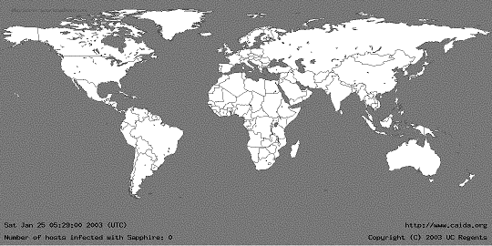
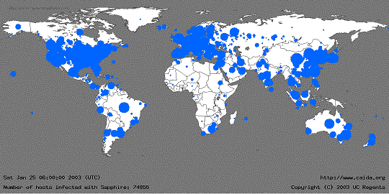
SQL Slammer

Slide 48
Current Trends

Slide 49
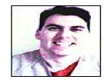


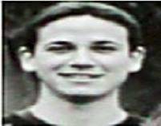
Historical hackers (prior to 2000)
Profile:
Male
Between 14 and 34 years of age
Computer addicted
No social life
No Commercial Interest !!!
Source: Raimund Genes

Slide 50
Historical Hackers
1990s:
Phone phreaking, Free calls
Early 2000s:
Email worms
CodeRed, Nimda

Slide 51
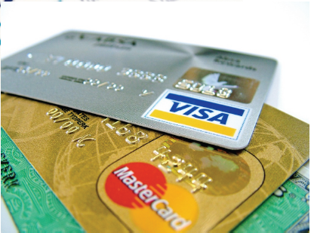
Financially Motivated
Shift in late 2000s
Spam
Pharmaceuticals
Fake products
Carding/Fraud
Identify theft, credit fraud

Slide 52

Politically Motivated
Stuxnet

Slide 53
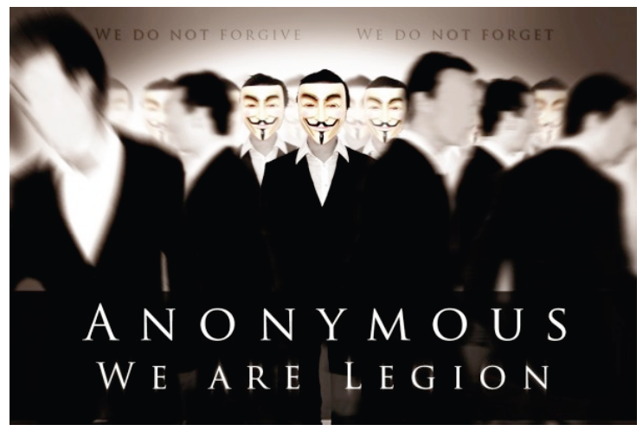
Politically Motivated

Slide 54
Typical Botherder: 0x80" (pronounced X-eighty)
High school dropout
“…most of these people infect are so stupid they really ain't got no business being on the Internet in the first place.“
Working hours: approx. 2 minutes/day to manage Botnet
Monthly earnings: $6,800 on average
Daily Activities:
Chatting with people while his bots make him money
Recently paid $800 for an hour alone in a VIP room ….
Job Description:
Controls 13,000+ computers in more than 20 countries
Infected Bot PCs download Adware then search for new victim PCs
Adware displays ads and mines data on victim's online browsing habits.
Bots collect password, e-mail address, SS#, credit and banking data
Washington Post: Invasion of the Computer Snatchers

Slide 55
Some things in the news
Nigerian letter (419 Scams) still works:
Michigan Treasurer Sends 1.2MUSD of State Funds !!!
Many zero-day attacks
Google, Excel, Word, Powerpoint, Office …
Criminal access to important devices
Numerous lost, stolen laptops, storage media, containing customer information
Second-hand computers (hard drives) pose risk
Vint Cerf estimates ¼ of PCs on Internet are bots

Slide 56
Trends since 2010
Texas CISO, Feb 2010
Malware, worms, and Trojan horses
spread by email, instant messaging, malicious or infected websites
Botnets and zombies
improving their encryption capabilities, more difficult to detect
Scareware – fake/rogue security software
Attacks on client-side software
browsers, media players, PDF readers, etc.
Ransom attacks
malware encrypts hard drives, or DDOS attack
Social network attacks
Users’ trust in online friends makes these networks a prime target.
Cloud Computing - growing use will make this a prime target for attack.
Web Applications - developed with inadequate security controls
Budget cuts - problem for security personnel and a boom to cyber criminals.
Same list in Oklahoma Monthly Security Tips Newsletter

Slide 57
Monetization of Exploits

Slide 58
Marketplace for Vulnerabilities
Option 1: Bug Bounty Programs
Google vulnerability reward program: 3K $
Mozilla big bounty program: 500 $
Pwn2Own competition: 15K $
Option 2:
ZDI, iDefense purchases: 2K-10K $
Zero Day Initiative | 3Com | TippingPoint, a division of 3Com, http://www.zerodayinitiative.com/
Vulnerability Contributor Program // iDefense Labs, http://labs.idefense.com/vcp/

Slide 59
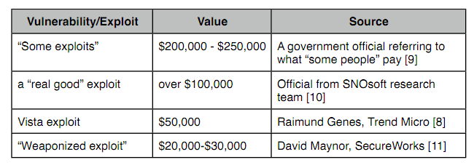
Marketplace for Vulnerabilities
Option 3: Black Market
Source: Charlie Miller (http://securityevaluators.com/files/papers/0daymarket.pdf). This is a very good read, also discussed the challenges involving legitimate buyers.

Slide 60
Underground Economy
Spam service
Rent-a-bot
Cash-out

Slide 61
The Pay-Per-Install business model (PPI) has existed for years. When the PPI business first started, it was used to distribute advertisements. Today it is mainly used to spread spyware and malware.
These PPI sites create an underground economy that profits from installing malware. This economy is so widespread that there is even a side business selling programs to make it more difficult for computer users to detect that they are installing something malicious.
Notes:
Adware is unwanted software designed to throw advertisements up on your screen.” Adware generates revenue for its developer by automatically displaying online advertisements in the user interface of the software or on a screen that pops up in the user's face during the installation process.

Slide 62
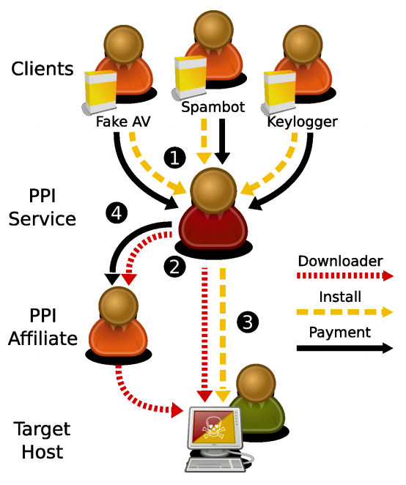
Marketplace for Pay-Per-Install (PPI)
Credit: Zulfikar Ramzan

Slide 63
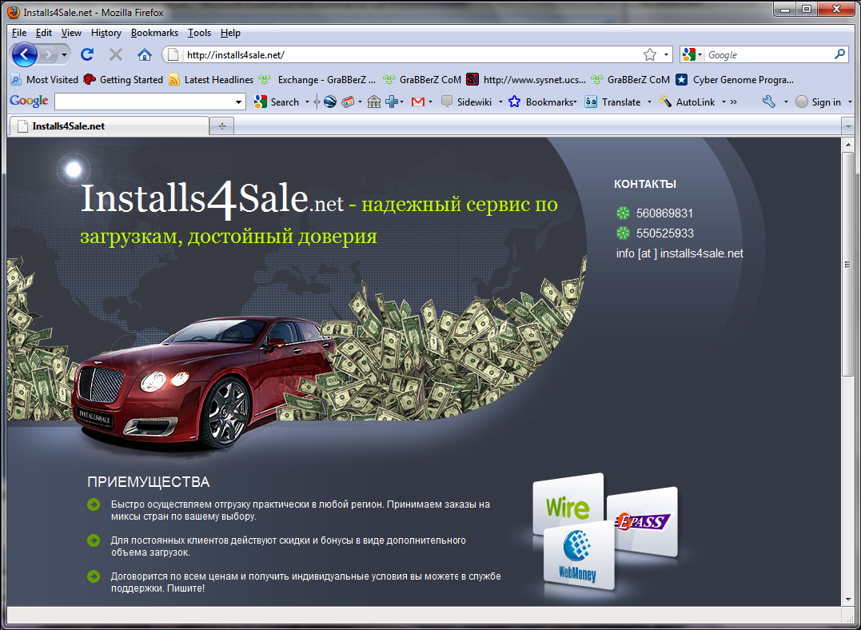

Slide 64


Slide 65
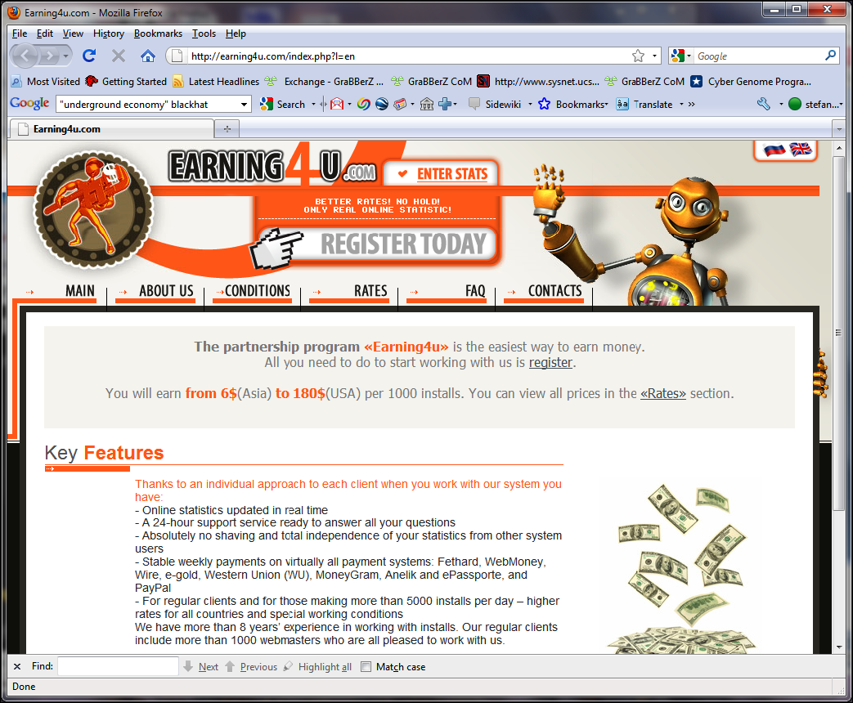

Slide 66
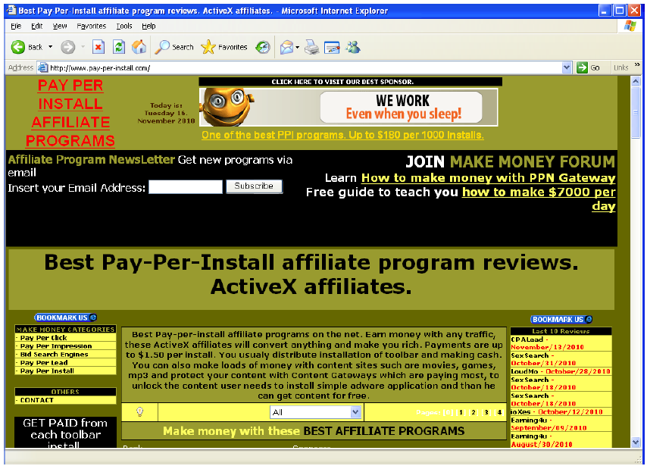

Slide 67
Recommended reading
The Underground Economy of the Pay-Per-Install (PPI) Business by Kevin Stevens
Measuring Pay-per-Install: The Commoditization of Malware Distribution by Juan Caballero (Usenix Sec 2011)

Slide 68
Why are there security vulnerabilities?
Lots of buggy software...
Why do programmers write insecure code?
Awareness is the main issue
Some contributing factors
Few courses in computer security
Programming text books do not emphasize security
Few security audits
C is an unsafe language
Programmers have many other things to worry about
Legacy software (some solutions, e.g. Sandboxing)
Consumers do not care about security
Security is expensive and takes time

Slide 69
If you remember only one thing from this course:
A vulnerability that is “too complicated for anyone to ever find” will be found !
I hope you remember more than one thing

Slide 70
Summary

Slide 71
Summary
Threat landscape is highly dynamic as it is driven by economic motivation, and especially organized crime
No “final state of security”
Prevention not always possible; intelligent response mechanisms are strongly needed.

Slide 72
Acknowledgements
Material in this lecture are taken from the slides prepared by:
Prof. Dr. Konrad Rieck (Uni-Göttingen)
Prof. Dr. Sufian Hameed (FAST NUCES KAR)
Edited by Lecturer Abdullah Bin Zarshaid

Slide 73
Web Resources
Book Web site: http://williamstallings.com/NetworkSecurity
Student resources
Other Web sites:
(p.38)

